Slide 1


VISVESVARAYA TECHNOLOGICAL UNIVERSITY
Jnana Sangama, Belagavi - 590 014
COMPUTER SCIENCE AND ENGINEERING DEPARTMENT
Mini Project Presentation on
“Computer Science and Engineering Department Web Page”
Presenting by: Prajwal S(1VK17CS039)
Roushan Raja(1VK17CS047)
Sudhanva Shrivallabha Pangari (1VK17CS061)
GUIDED BY :
Mr Lakshmikantha G C
Asst.Prof. Dept. of CS&E VKIT, Bengaluru

Slide 2
ABSTRACT
Computer Science and Engineering department webpage provides an opportunities for students to go through the webpage learn more about the college and its environment, its aim, goals, mission and opportunities. Also to enquire about the college by collecting phone number or mail id from the website, the user can even get the college address. The webpage has some pictures about the Computer Science and Engineering department and its labs. The webpage also has all the teacher names and qualification and is user friendly and provides as much as information required.

Slide 3
INTRODUCTION
Computer Science and Engineering department webpage in a collage website plays a major role in giving information more deeply to the visitors from which colleges can grab their attention. In our project we mainly focus on Computer Science and Engineering department of a collage and try to give best to the users. So mainly we focus on 5 different categories such as Home, About us, Gallery, Teachers and Contact. In addition to this we will give brief description about computer science and engineering mission and visions.
Here we would provide even description of the categories and if they are interested in knowing more then they have an option to know more about the Computer Science and Engineering department by mailing the college for enquires or contacting them.

Slide 4
Websites Visited
https://www.w3schools.com/w3css/w3css_slideshow.asp
https://www.w3schools.com/html/html_images.asp
https://www.template.net/.../mentoring-action-plan-template
https://en.wikipedia.org/wiki/Blog
https://edublogs.org
https://www.launchora.com

Slide 5

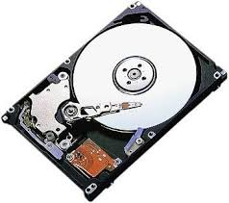
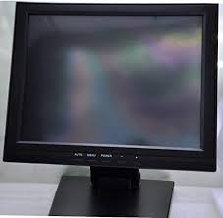
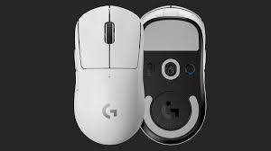
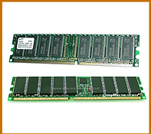
HARDWARE AND SOFTWARE REQUIREMENT
HARDWARE:
System : Intel Core i3 and above.
Hard Disk : 40 GB.
Monitor : 15 VGA Colour.
Mouse : Logitech.
Ram : 512 Mb

Slide 6




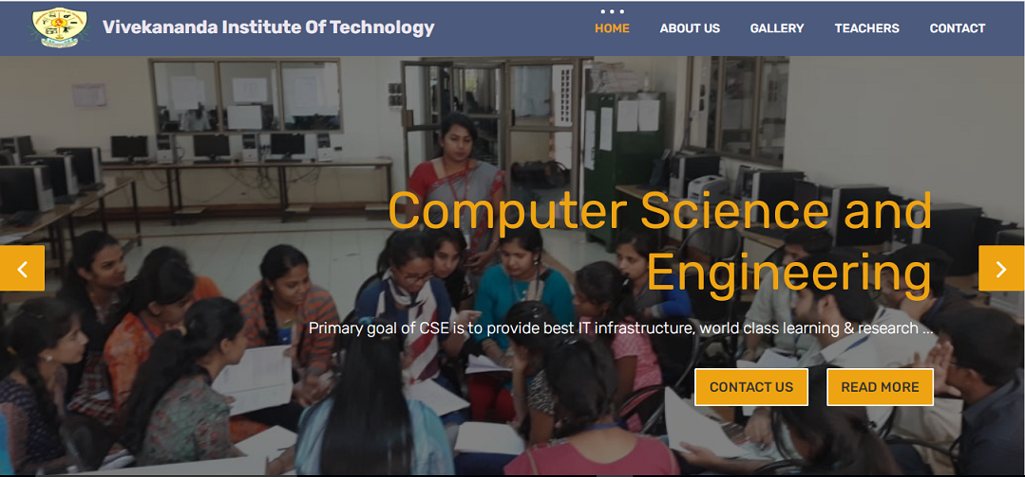
SOFTWARE:
Operating system : Platform Independent
Software Tool : VS Code
Server :XAMPP .

Slide 7
DESIGN
HOME PAGE
ABOUT US
GALLERY
TEACHERS
LABORATORY
CONTACT US
TESTIMONIALS
EMAIL SMTP
GOOGLE MAP

Slide 8




TECHNOLOGIES USED:
Software Tool : VS Code
Coding Language : JavaScript, PHP, HTML, Bootstrap.
Toolbox : PHPMailer.

Slide 9


Slide 10
REFERANCES
Randy Conolly, Ricardo Hoar, “Fundamentals of Web Development”, 1st Edition Pearson Education India.
Robin Nixon, “Learning PHP, MySQL & JavaScript with Jquery, CSS and HTML5”, 4th Edition,
O’Reilly Publications, 2015.
Luke Welling, Laura Thomson, “PHP and MySQL Web Development”, 5th Edition,Pearson Education, 2016.
David Sawyer McFarland, “JavaScript & JQuery”, 1st Edition, O’Reilly/Shroff Publishers & Distributors Pvt Ltd, 2014.

